Slide 1
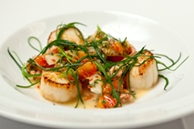
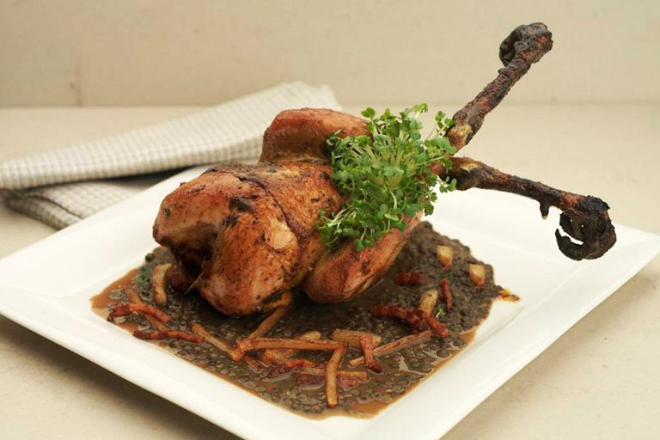
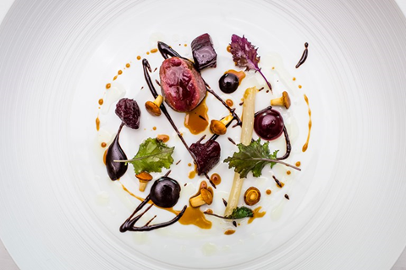
Wild Foods! o
"Haute Cuisine"
Lynn Landes, Founder
WildFoodies.org

Slide 2
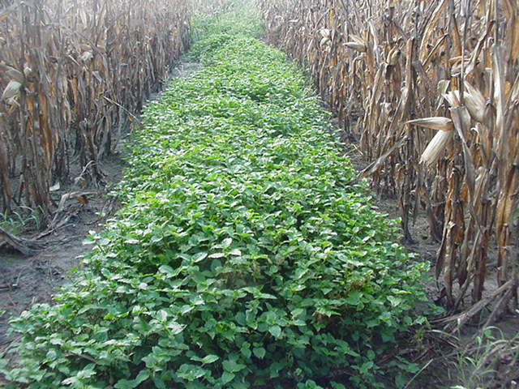
A Co-Harvest Opportunity!
L
They’re free, nutritious, delicious & haute!

Slide 3
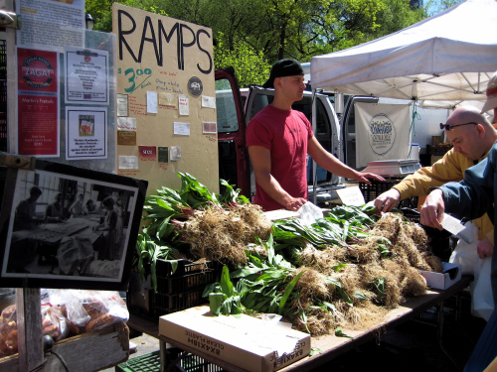
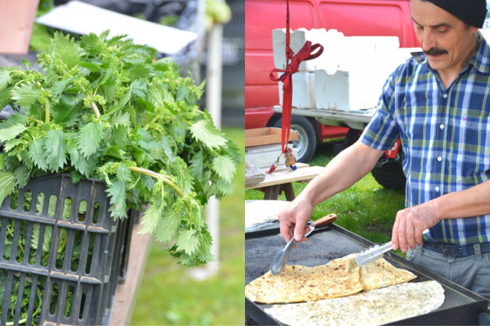
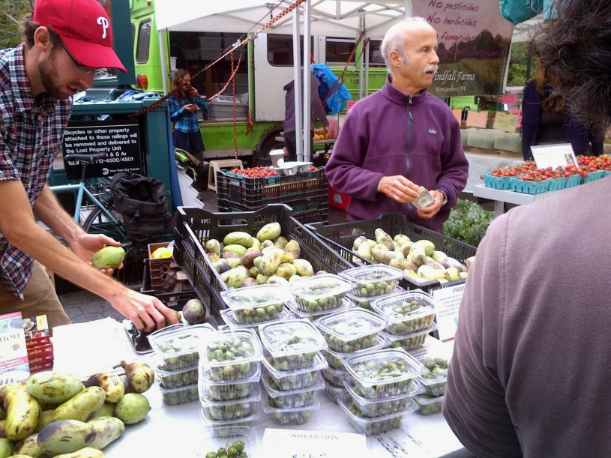
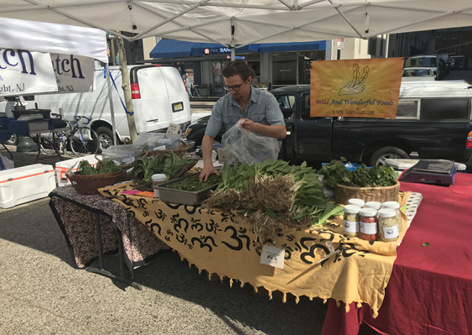
0
Going Wild @ Farmers Markets & Stores!

Slide 4
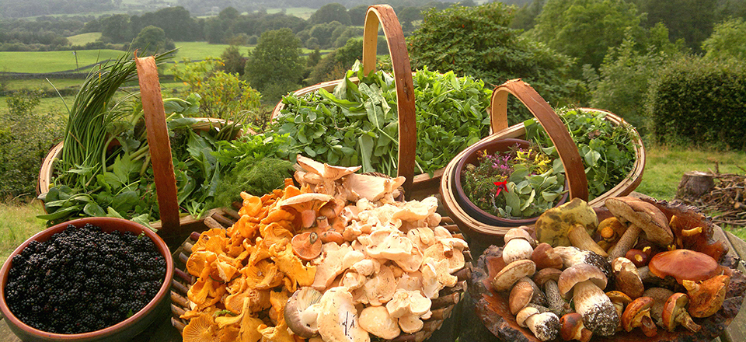
“Chefs around the world are using foraged ingredients to add exciting, fresh, and eco-friendly flavors to their menus.” Food Tank
“Across the planet — from Australia to the Faroe Islands — the culinary world is rediscovering a very old idea, foraging for food.” First We Eat
“Top restaurants are going crazy for these secret ingredients found in the wild”
Business Insider

Slide 5
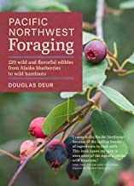

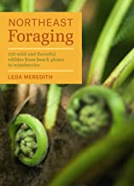
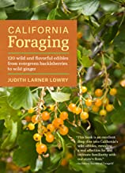
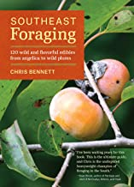
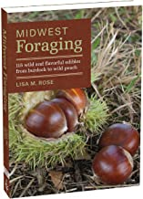
WildFoodes.org: Books & Online Reference Info

Slide 6
230+ WILD EDIBLES in Mid-Atlantic Region
PLANTS: American groundnut American peanut Amaranth: - common - mat - spiny - Lamb’s quarters Arrowhead, wapato - Arrow Arum, white Artemesia: - epazote, wormseed - mugwort,wormwood - sweet Annie Asparagus Brookweed Bunchberry Carrot family: - carrot - goutweed - eastern waterleaf - sweet cicely - aniseroot Carpetweed Chameleon Chamomile: - wild - pineappleweed Chickweed: - common - fuzzy, mouse-ear - sticky mouse-ear Cleaver Clover: - red - white Daylily Dock/Sorrel: - bitter dock - curly yellow dock - patience dock - sheep sorrel - wood sorrel, oxalis | Duckweed Evening primrose Evergreen, berries: - Wintergreen - Creeping snowberry - Lingonberry - Partridgeberry - American cranberry - Bog cranberry Fiddlehead fern Ginger Goldenrod Grass: - Asiatic dayflower - bamboo - cattail - grass - crabgrass - knotgrass - knotweed,Japanese - reedgrass - LadysThumb - pepper grasss - spiderwort - wild rice Hosta Jewelweed Kudzu Lettuce-Like: - chicory - dandelion - lettuce, wild - lettuce, prickly - sow thistle Mallow/Hibiscus family: - common - high - marshmallow - Rose of Sharon - velvet leaf mallow Mayapple Milkweed | Mint: groundcover - ground ivy - henbit - purple deadnettle Mint: upright - anise hyssop - bee balm, scarlet - bee balm, wild - horsemint - giant hyssop - lemon balm - mountain mint - shiso, beafsteak - spearmint - watermint Mullein Mustard & Cress: - mustard - garlic mustard & cress: - bittercress - pennycress - peppercress - Sheperd’s purse - watercress - wintercress Nettle: - clearweed - stinging - wood Nightshade: - ground cherry - black nightshade Onion & Garlic: - garlic, wild - onion grass - ramps Pickerelweed Plantain/Plantago: - broad leaf - narrow leaf Pokeweed Prickly pear | Purple loosestrife Purslane Salsify Solomon Seal: - common - false Speedwell Spring beauty Strawberry: - Indian - wild Sunflower: - sunchoke - sunflower Thistle: - bull - burdock - field - milk Violet, wild Water chestnut Water hyacinth Water lilies: - American lotus - yellow pond lily Yarrow Yucca VINES: Grapevine & related: - grape, riverbank - porcelainberry Greenbrier/Smilax Hardy kiwi Honeysuckle,Japanese Hyacinth bean Kudzu Mile-a-minute Passion vine Potato vine | BUSHES: Asian Lemon Autumnberry/olive Bayberry, northern Barberry Beach plum Beautyberry Blueberry-like: - high bush - low bush - chokeberry, black - chokeberry, red - huckleberry, black - huckleberry, box Devil's walking stick Elderberry Holly: - inkberry - winterberry Mahonia Raspberry & related: - blackberry, Allegheny - blackberry, sawtooth - dewberry - raspberry, black - raspberry, red - wineberry Ribes: - currant, clove - gooseberry. prickly Rose: - multiflora rose - rose, many species - RosaRugosa Rose of Sharon Spicebush Sumac: - Sumac, fragrant - Sumac, staghorn - Sumac, winged Vibernum: - black haw - high bush cranberry - nannyberry | TREES: Apple & related: - Callery pear - crab apple - hackberry - hawthorn - plum - quince - rowan Aspen, American Beech, American Birch, sweet Cherry & related: - black cherry - chokecherry - pin cherry Conifers & related: - fir, balsam - hemlock - juniper - larch - pine, white - spruce, Norway Cottonwood Dogwood: - cornelian dogwood - kousa Elm: Elm, Chinese Elm, slippery Elm, Siberian Empress Ginkgo Hazelnut, American Hickory. shagbark Holly, American Juneberry Linden/basswood Locust & related: - black locust - honey locust - Kentucky coffee tree Maple family Mimosa | Mulberry & related: - black - paper - red - white Redbud Oaks: - chinquapin - pin - red - white Paw Paw Persimmon Sassafras Sweetgum Sycamore Tulip poplar Willow, black Walnut & related: - black - butternut

Slide 7
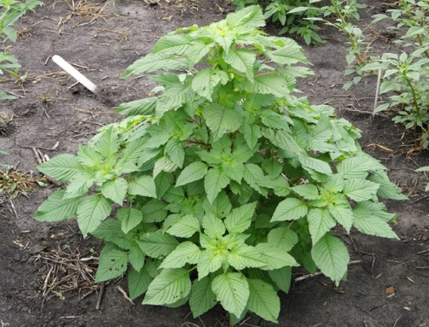
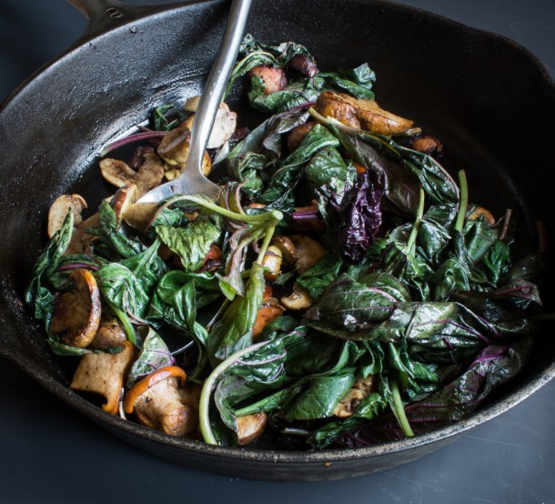
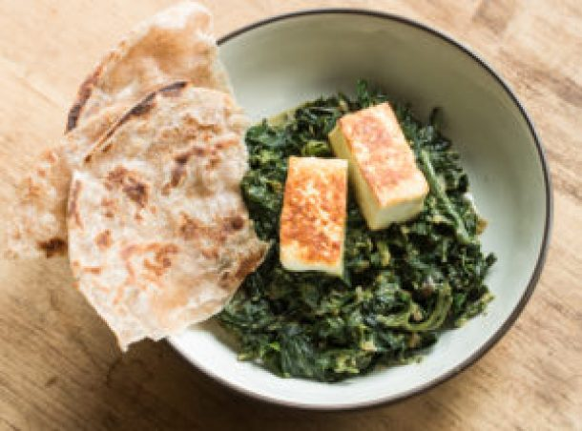
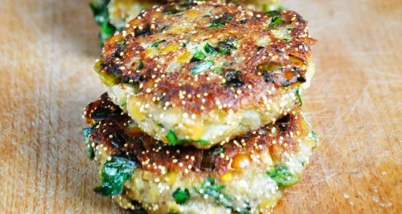
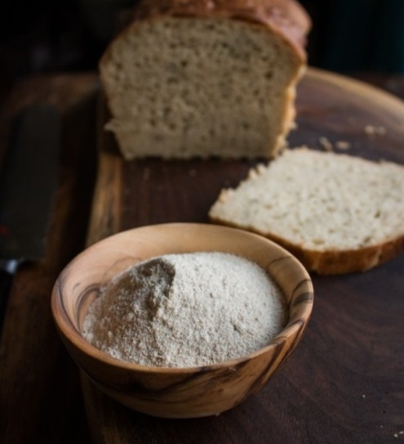
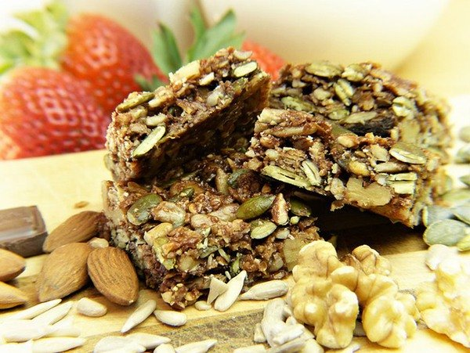
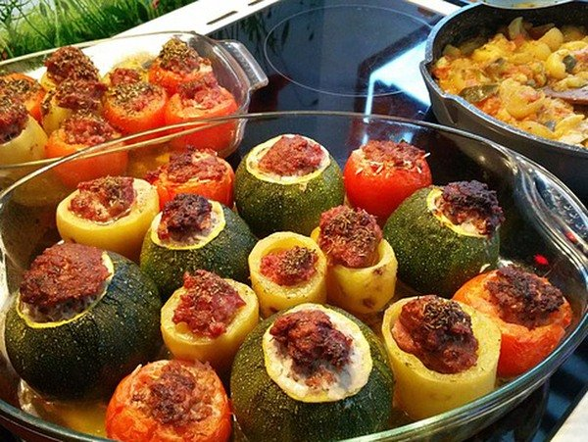
AMARANTH - pigweed or Aztec Superfood?

Slide 8
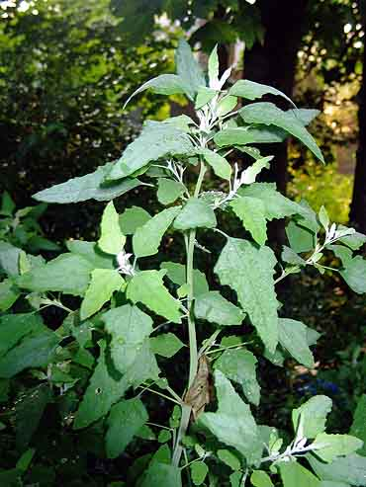
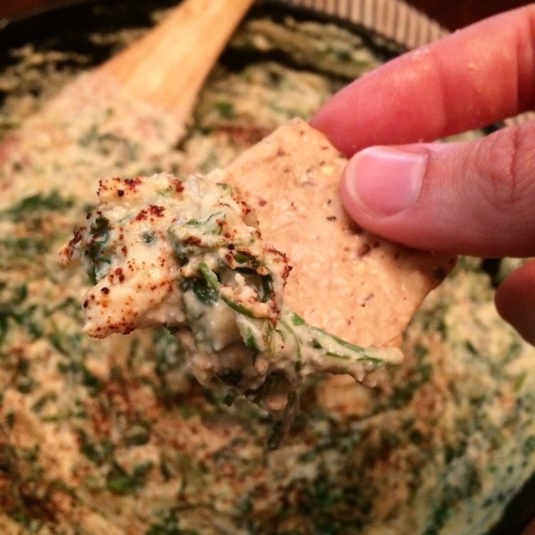
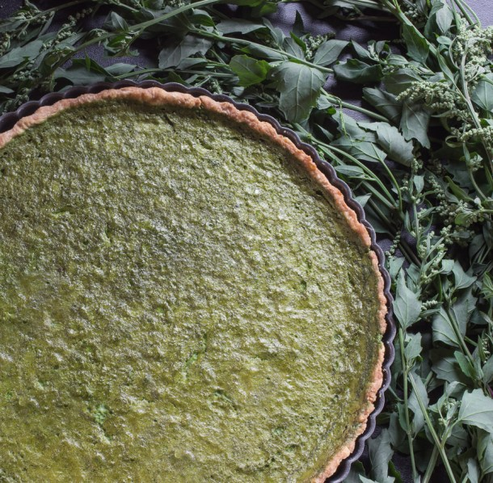
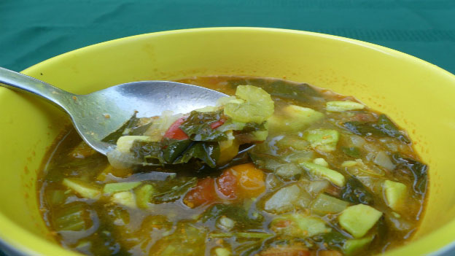
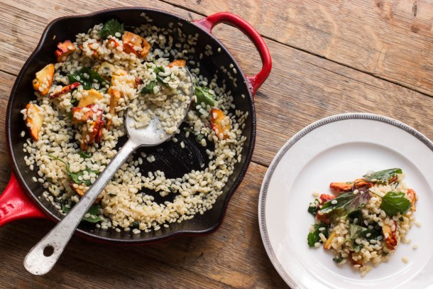
LAMB’S QUARTERS aka wild spinach

Slide 9
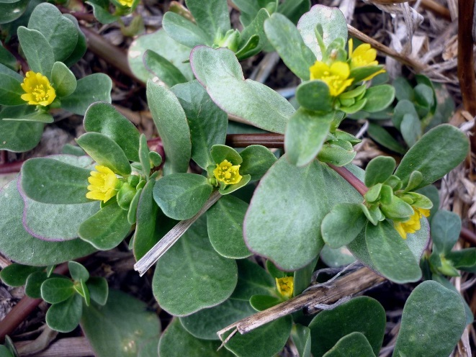
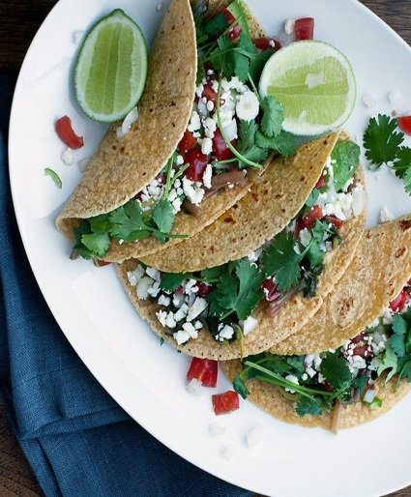
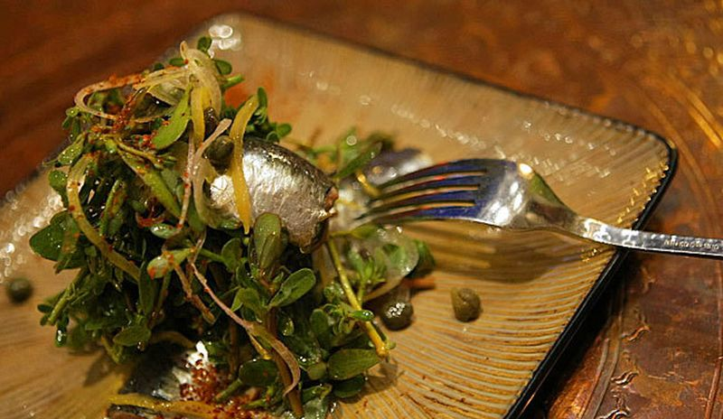
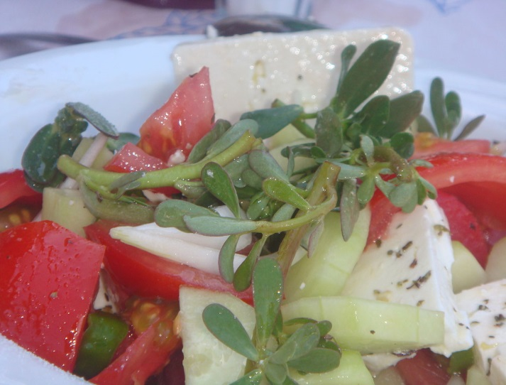
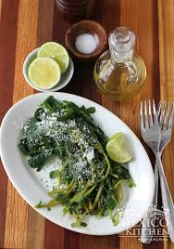
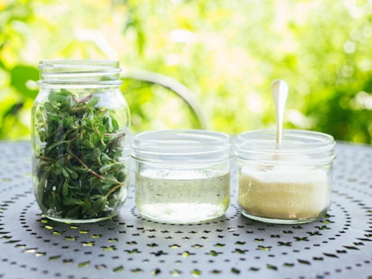
PURSLANE - popular Mediterranean food!

Slide 10
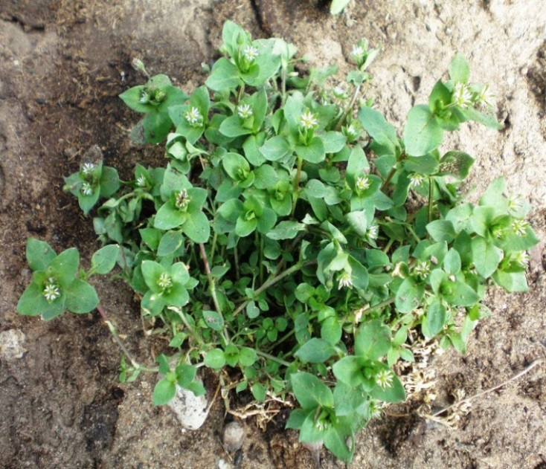
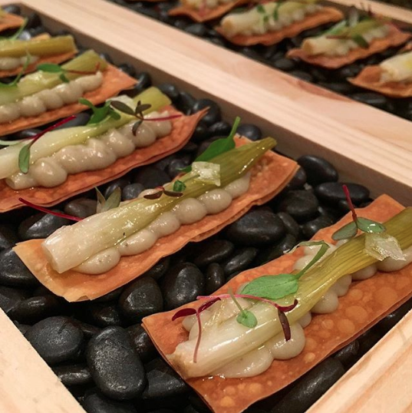
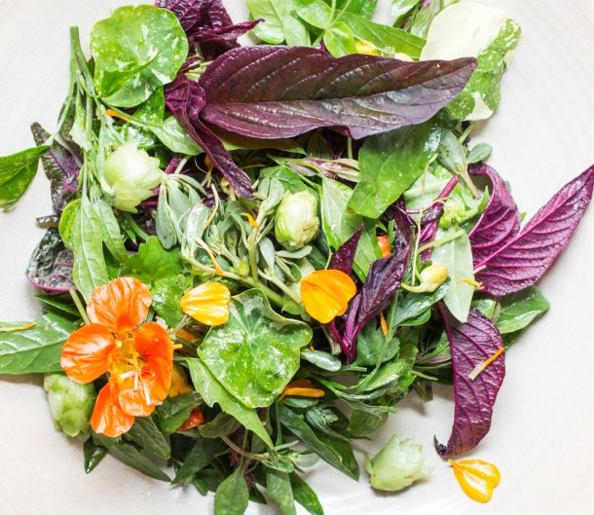
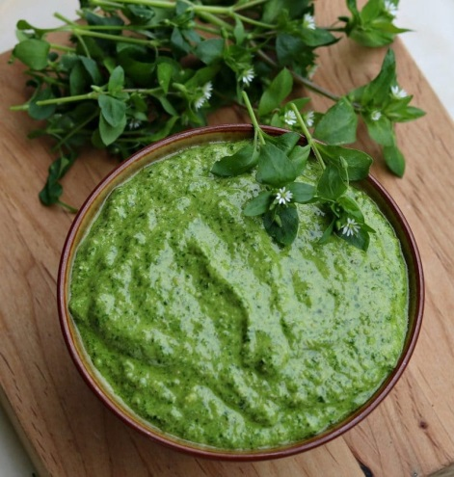
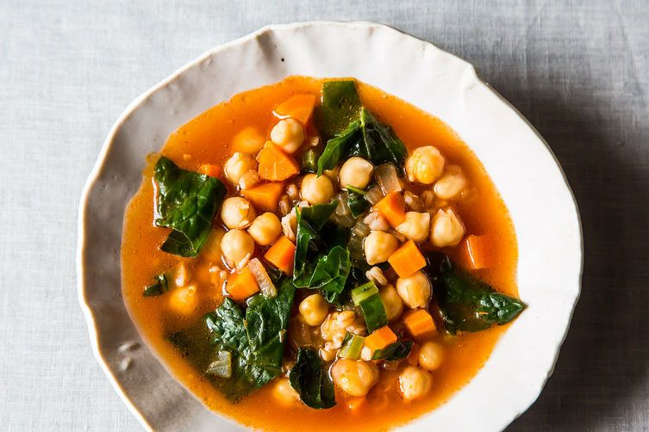
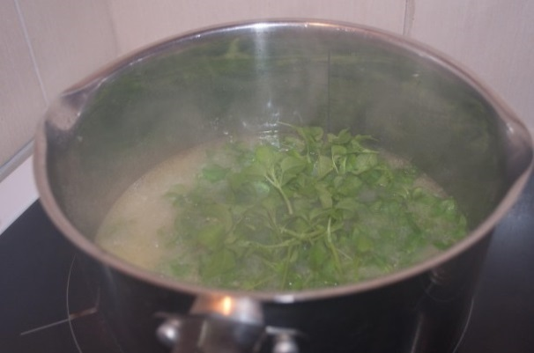
CHICKWEED - cold weather microgreen!

Slide 11
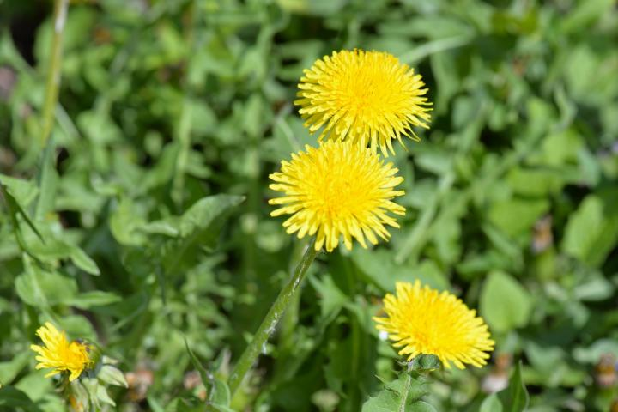
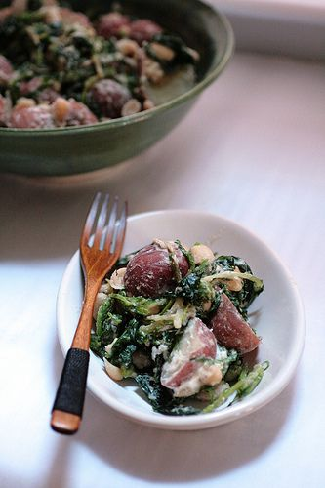
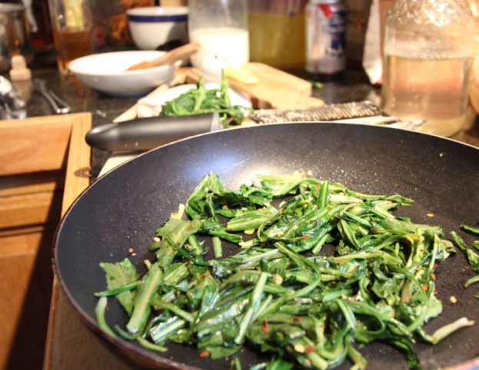
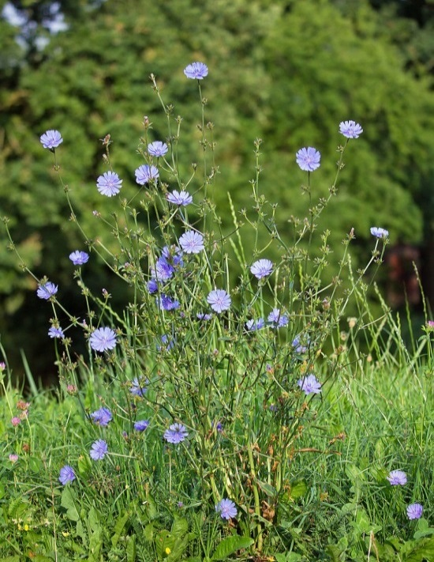

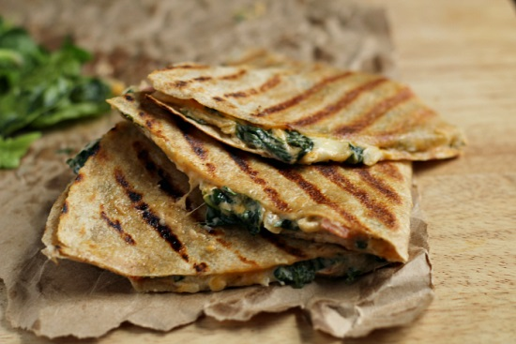
DANDELIONS & CHICORY l leaves, flowers, & roots for more than just coffee

Slide 12
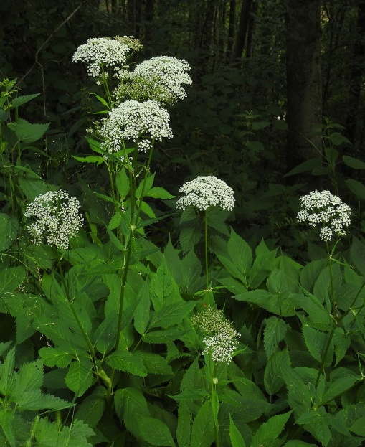

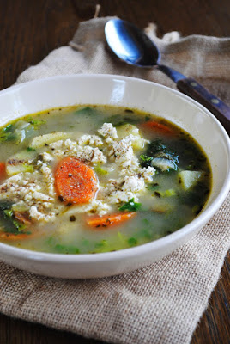
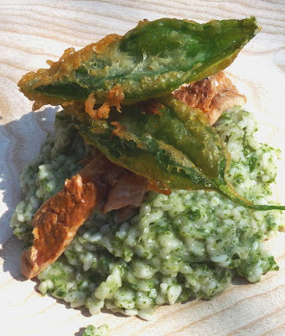
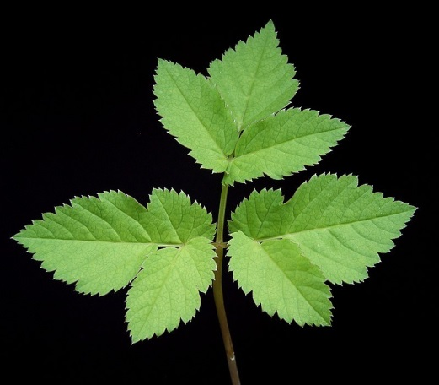
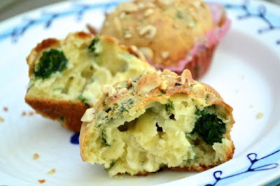
BISHOP’S GOUTWEED - aka wild parsley

Slide 13
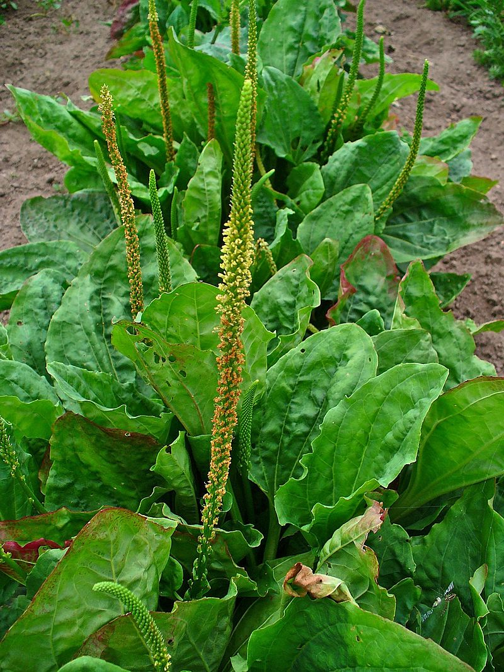
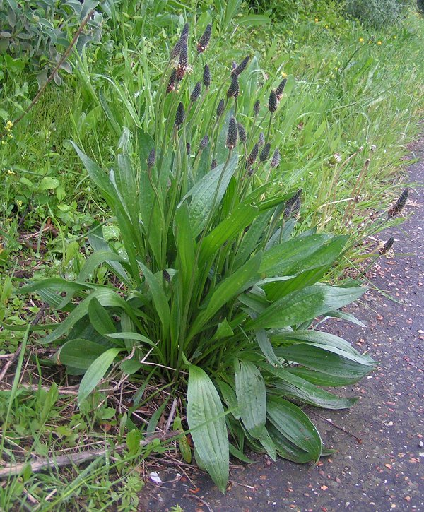


PLANTAINS - broad & narrow leaf o mushroom taste & powerhouse medicinal

Slide 14











ONION GRASS & WILD GARLIC

Slide 15






MUGWORT - a sage substitute

Slide 16


Slide 17






THE MUSTARD FAMILY
L field mustard, peppercress, watercress, garlic mustard wintercress , Sheperd’s purse

Slide 18







BITTERCRESS

Slide 19






PENNYCRESS leaves, seeds & taproot

Slide 20






DOCKS & SORRELS – lemony delights! l patience, curly, bitter - wood sorrel & sheep sorrel

Slide 21






PATIENCE DOCK – crispy or cooked

Slide 22


SUNCHOKES - aka Jerusalem Artichoke o
“A lesson in education & preparation”
BEFORE you cook or sell SUNCHOKES, SOAK them
for 24 hours, replace water after first 12 hours!

Slide 23






BURDOCK ROOT – artichoke flavor l a comforting broth, perfect with wild rice, mushrooms & greens

Slide 24








SATISFYING SALSIFY

Slide 25










EDIBLE TREE LEAVES? THINK KALE CHIPS & WRAPS maple, hawthorn, elm, linden, birch, beech, empress, sassafras, mulberry, paper mulberry

Slide 26






SASSAFRAS for “gumbo” and “root beer”

Slide 27






BLACK LOCUST ‘WHITE BLOSSOMS’

Slide 28








HONEY LOCUST PODS l think “peas & carobs”

Slide 29





SPRUCE, FUR & HEMLOCK TIPS

Slide 30





A CHAMELEON CACOPHONY l ginger - mint - cilantro flavour

Slide 31








BLACK NIGHTSHADE l bridging the blueberry-tomato divide

Slide 32




EXOTIC INVASIVES l lPAPER MULBERRY & ASIAN LEMON

Slide 33





MARVELOUS MULBERRIES!

Slide 34







ROSE OF SHARON put some ‘romance’ in your recipes!

Slide 35

THANK YOU FOR WATCHING!
Lynn Landes, Founder
l
ll
(Philadelphia Inquirer photo)
Wild Foodies.org
(4,800+ members)

Slide 36

WHY HARVEST WILD FOODS?
Truly Sustainable – Wild foods can survive and multiply without human assistance, unlike crops that are hybridized, selectively bred, or genetically modified.
Real Food Security – Although “food security” is often portrayed as a sufficient number of grocery stores within a given area, 'real' food security is available through the mindful harvesting & careful cultivation of our local wild resources.
Nutritionally Diverse - Plants that grow in the wild and diverse environment makes them more nutritious than similar plants grown using conventional farming practices.
Connects People to Nature - The mind-stomach-nature connection is a powerful one, particularly as people learn that many of the plants they routinely ‘walk on’ are important sources of food, fiber, and medicine!

